Slide 1
E-COMMERCE & RETAIL
OLIST E-COMMERCE ANALYSIS
EXCEL
BANKING & FINANCIAL SERVICES
End-to-End E-Commerce Analytics using SQL, Excel, Power BI & Tableau
OLIST E-COMMERCE ANALYTICS
End-to-End Banking Analytics using SQL, Excel, Power BI & Tableau
TABLEAU
SQL
EXCEL
POWER BI
TABLEAU

Slide 2









01
02
03
Introduction
Key Performance Indicators (KPIs)
Excel Dashboard
04
05
06
CONTENTS
Table of
Contents
Power BI Dashboard
Tableau Dashboard
SQL Queries & Results
07
08
09
Challenges Faced
Conclusion
Thank You
OLIST E-COMMERCE ANALYTICS
02

Slide 3


PROJECT OVERVIEW
01. Introduction
PROJECT BACKGROUND
CORE OBJECTIVES
The Olist E-Commerce Analytics Dashboard transforms raw Brazilian e-commerce data into actionable business insights using SQL, Excel, Power BI and Tableau. The project combines customer, order, payment, product and review information to understand sales performance, delivery experience and customer behavior.
1
Analyze order, payment and revenue performance
2
Measure delivery time and shipping efficiency
3
Understand customer review-score patterns
4
Identify top product categories and payment methods
5
Compare weekday and weekend payment behavior
6
Create interactive dashboards for business decisions
OLIST E-COMMERCE ANALYTICS
03

Slide 4











METRICS TRACKED
02. Key Performance Indicators (KPIs)
Core metrics used across the Olist e-commerce dashboards to evaluate orders, payments, delivery and customer experience.
Total Orders
Total Payment
5-Star Credit Card Orders
Average Pet Shop Delivery Days
São Paulo Average Price
São Paulo Average Payment
Payment Method Distribution
Review Score Distribution
Monthly Order Trend
Shipping Days vs Review Score
Product Category Sales
OLIST E-COMMERCE ANALYTICS
04

Slide 5
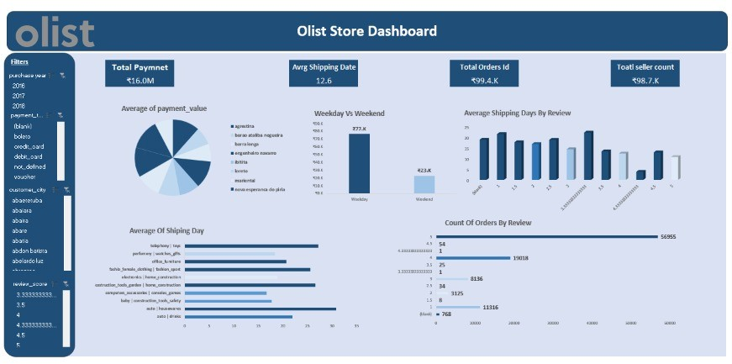

BUSINESS REPORTING
03. Excel Dashboard – Olist E-Commerce
Pivot-driven reporting layer for order, payment, shipping and customer analysis — built for fast self-service exploration.
EXCEL DEVELOPMENT
Cleaned and merged the Olist e-commerce datasets before analysis.
Built an interactive Excel dashboard using Pivot Tables, Pivot Charts, KPI cards, slicers and conditional formatting.
Key views include payment behavior, shipping days, review scores, product categories and order trends.
OLIST E-COMMERCE ANALYSIS
05

Slide 6
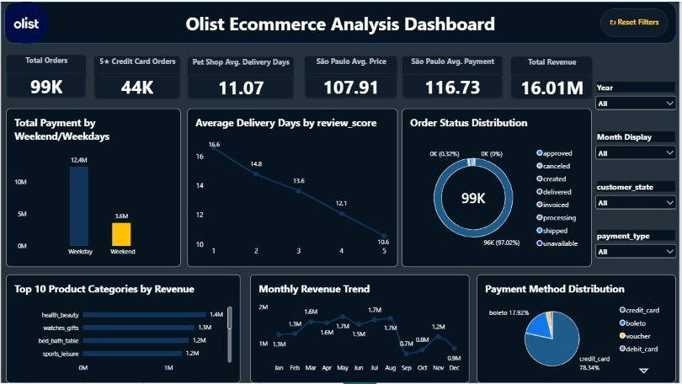
MODELING & INTERACTIVITY
04. Power BI Dashboard – Olist E-Commerce
A modeled analytical layer with interactive KPI cards, filters and visuals for executive-level e-commerce insights.
POWER BI DEVELOPMENT
Imported the cleaned Olist dataset into Power BI and prepared analytical fields.
Created measures and visuals for total orders, revenue, delivery performance, payment behavior and customer reviews.
Interactive filters allow users to explore year, month, customer status and payment type.
OLIST E-COMMERCE ANALYSIS
06

Slide 7
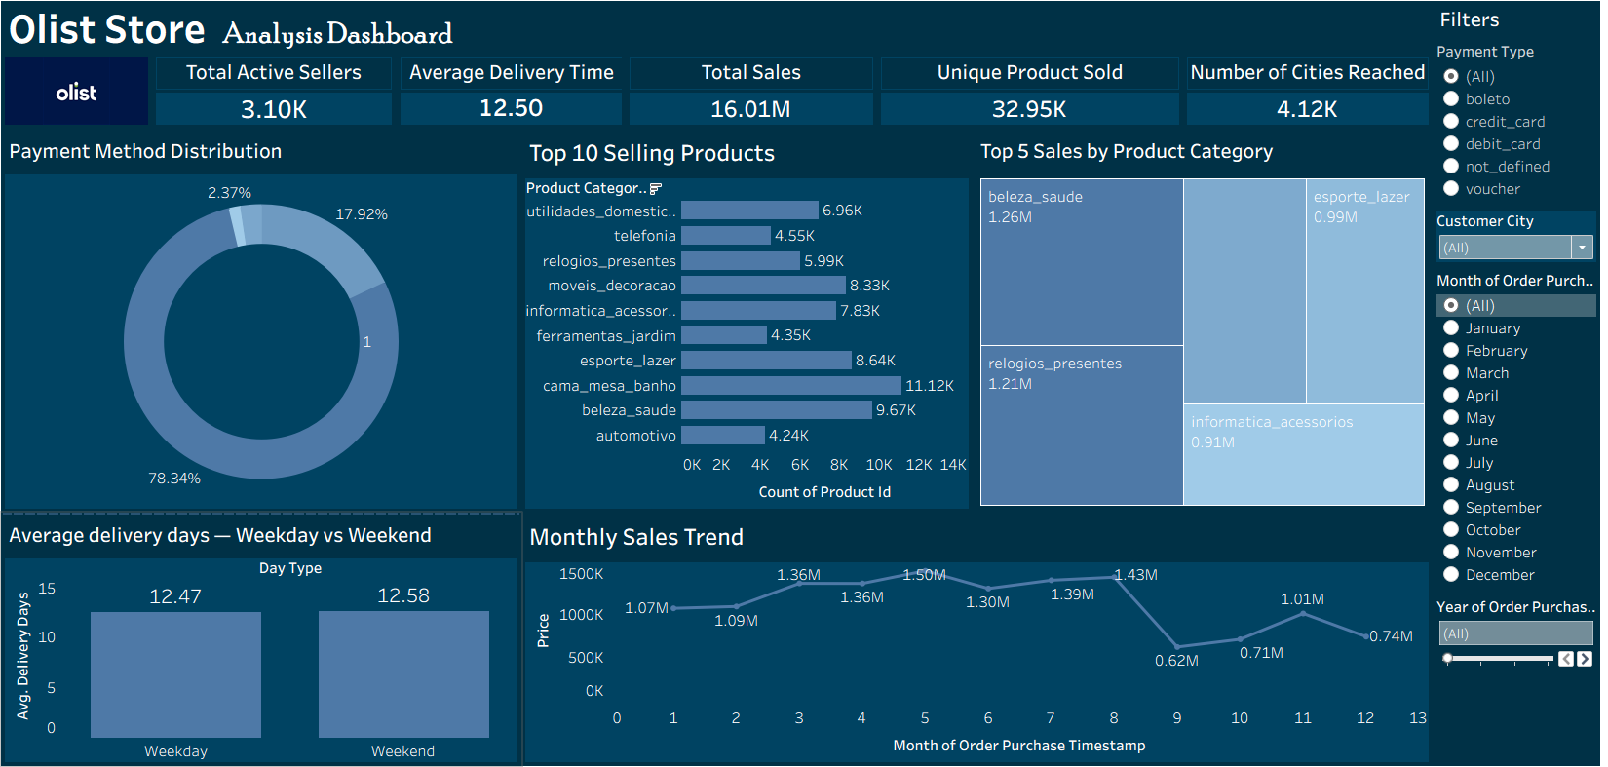


MODELING & INTERACTIVITY
05. Tableau Dashboard – Olist E-Commerce
Interactive visualizations highlighting order trends, payment methods, product categories, reviews and delivery performance.
TABLEAU DEVELOPMENT
Connected the cleaned Olist dataset to Tableau for interactive visual analytics.
Created calculated views for order trends, payment distribution, review scores, sales by product category and shipping analysis.
Filters and dashboard interactions support quick exploration of customer and order behavior.
OLIST E-COMMERCE ANALYSIS
07

Slide 8
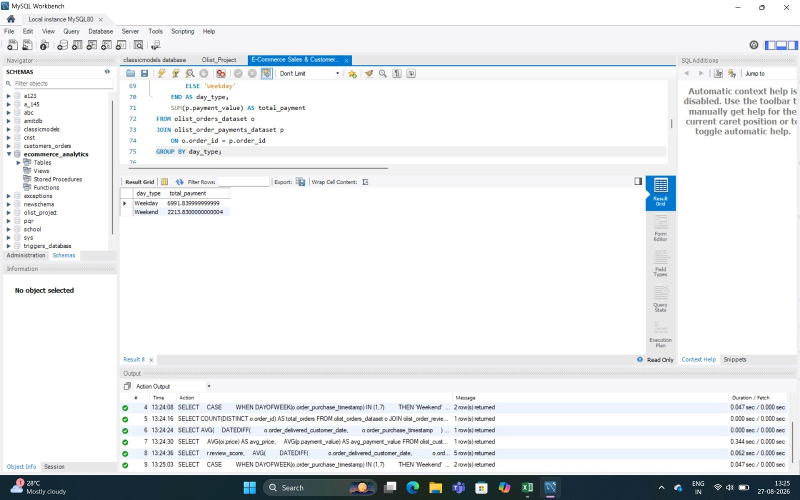
MODELING & INTERACTIVITY
06. SQL Queries & Results
SQL-based extraction, transformation and KPI validation using the Olist e-commerce dataset.
SQL ANALYSIS
Used MySQL to query the cleaned Olist data and validate business KPIs.
Applied SELECT, CASE, JOIN, WHERE, GROUP BY, ORDER BY, COUNT, SUM and AVG for analysis.
The SQL results were used to validate payment, delivery, review and order metrics shown in the dashboards.
OLIST E-COMMERCE ANALYSIS
08

Slide 9

CROSS-PLATFORM ANALYTICS
07. Dashboard Insights
Key observations surfaced across the Olist Excel, Power BI and Tableau dashboards.
KEY INSIGHTS
• Nearly 99K orders were analyzed across the Olist dataset.
• Credit card is the dominant payment method in the analysis.
• Review score 5 has the highest number of orders.
• Health & beauty, watches & gifts and bed & bath appear among leading product categories by revenue.
• Delivery duration varies across products/categories, making shipping performance an important customer-experience metric.
OLIST E-COMMERCE ANALYSIS
09

Slide 10
END-TO-END WORKFLOW
08. Project Workflow
A consistent pipeline connected data preparation, SQL validation and dashboard reporting.
ANALYTICS PIPELINE
1. Collect and merge Olist datasets
2. Clean missing values and standardize fields
3. Create calculated fields such as shipping days and day type
4. Validate KPIs using SQL
5. Build interactive Excel dashboard
6. Build Power BI and Tableau visual analytics
7. Compare outputs and derive business insights
OLIST E-COMMERCE ANALYSIS
10

Slide 11

RELATIONAL DATA EXTRACTION
09. SQL Queries & Results
SQL formed the analytical foundation for extracting, transforming and validating Olist business metrics.
SQL ANALYSIS
The MySQL analysis included:
• Weekday vs weekend payment analysis
• Total distinct order count
• Average delivery days
• Average product price and payment value for São Paulo
• Delivery days by review score
• Aggregations using CASE, JOIN, GROUP BY, SUM, AVG and COUNT.
OLIST E-COMMERCE ANALYSIS
11

Slide 12




CHALLENGES & RESOLUTIONS
10. Challenges Faced
Data Cleaning
KPI Preparation
DAX Optimization
CHALLENGE
CHALLENGE
CHALLENGE
Raw Olist tables contained nulls, duplicate records and inconsistent formats.
Multiple Olist tables had to be integrated into a consistent analytical structure.
Shipping-day and date calculations required consistent date handling.
SOLUTION
SOLUTION
SOLUTION
Cleaned and standardized fields before analysis.
Merged related datasets using order/customer/product keys and validated the resulting structure.
Created reliable calculated fields for delivery duration and date analysis.
Dashboard Performance
Interactive Reporting
CHALLENGE
CHALLENGE
The large Olist dataset could slow interactive visuals and filtering.
Maintaining consistent filters and interactions across tools required testing.
SOLUTION
SOLUTION
Reduced visual complexity and focused dashboards on decision-relevant metrics.
Tested filters and interactions across Excel, Power BI and Tableau.
OLIST E-COMMERCE ANALYSIS
12

Slide 13


SUMMARY & RECOMMENDATIONS
11. Conclusion
An end-to-end Olist e-commerce analytics solution was developed by combining SQL, Excel, Power BI and Tableau. The project converts raw transactional data into clear insights on orders, payments, product categories, delivery performance and customer reviews, enabling more informed business decisions.
RECOMMENDATIONS
Optimize Delivery
Improve Product Strategy
Focus on categories and sellers with longer delivery times to improve customer experience.
Use category-level revenue trends to prioritize high-performing products and identify growth opportunities.
Monitor Customer Experience
Automate Reporting
Track review scores alongside delivery duration to identify service issues early.
Maintain automated refresh and KPI validation across SQL, Power BI and Tableau.
OLIST E-COMMERCE ANALYSIS
13

Slide 14
12. Thank You
Questions & Discussion

